Slide 1

11gR2 RAC/Grid Clusterware and ASM
Shahique Anwer
Notes:
1

Slide 2
AGENDA
Introduction of Clusterware and Terminology
Advantage of RAC database
RAC Database Configuration
internal Structures and Services
OCR, Voting Disk and SCAN
VIP and Interconnect
Load Balancing and Failover and TAF
Clusterware Startup sequence
Node Eviction
Basic Command
ASM Overview
Disk and Disk Group and redundancy
Basic Command for ASM
2

Slide 3
Terminology
Instance ,Clusterware,Storage Area Network (SAN)
Database, Local Storage,
Shared Storage, SCAN,SCAN listener,OCR,Voting Disk
Raw Device,
Cluster File system ,Automatic Storage Management (ASM)
Single-instance DB, Multi-instance DB
3
Notes:
3

Slide 4
Introduction
Cluster
A cluster consists of a group of independent but interconnected computers whose combined resources can be applied to a processing task.
Most cluster architecture use dedicate network (cluster interconnect) for communication and coordination between cluster nodes.
Load-balancing clusters allow a single application to balance its workload across the cluster.
Clusterware
Clusterware is a software that provides various interfaces and services for a cluster. Clusterware allow the cluster to be managed as a single entity and protect the integrity of the cluster . It maintain a registry of resources so that their location is known across the cluster.

Slide 5
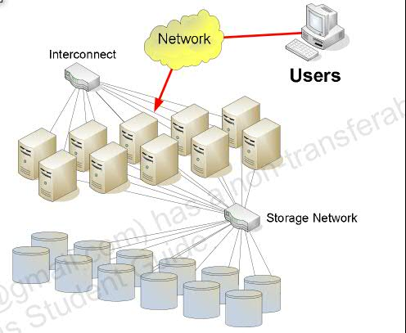
Component(Hardware)
1) Two or more nodes
2) shared storage
3) SAN(Storage Area Network)
4) NAS(Network Attached storage)
5)DAS(Direct Attached Storage)
6) Minimum two switches
7) Minimum 2 NIC card per each node
8) NIC means LAN Card
9) Minimum one SCSI Card each Node
10) LAN Cables

Slide 6
Introduced in Oracle 10.1 (Cluster Ready Services - CRS)
Renamed in Oracle 10.2 to Oracle Clusterware
Cluster Manager providing
  Node membership services
  Global resource management
  High availability functions
On Linux
  Implemented using three daemons
    CRS - Cluster Ready Service
    CSS - Cluster Synchronization Service
    EVM - Event Manager
In Oracle 10.2 includes High Availability framework
  Allows non-Oracle applications to be managed

Slide 7
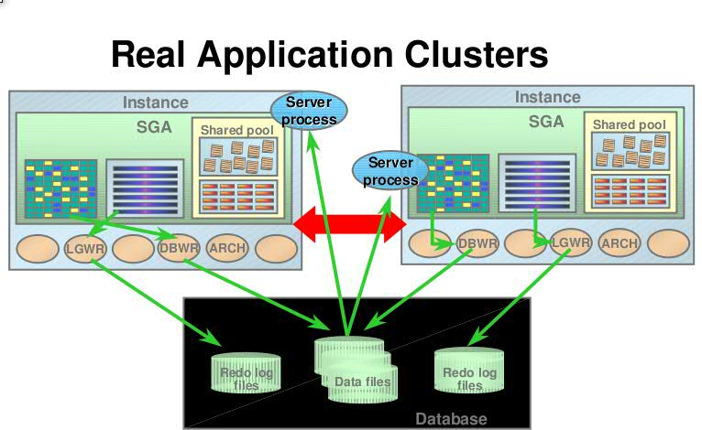

Slide 8
In Real Application Clusters, There are multiple instances (normally one per
database server node) serving a single database. The single database is stored on a
set of disks, that are shared between all instances.
The slide shows some of the characteristics of Real Application Clusters:
•All files are shared between all instances, this includes database, redo log,
parameter files, etc. There is only one set of database files, i.e. there is a single
database, that just can be seen from multiple nodes/instances. Each instance
actually has it’s own set of redo log files, but they are shared and visible to all
instances. This is used in case of recovery after loss of an instance.
•The instances are on separate nodes and do therefore not share any memory. All
coordination between the instances take place of the interconnect (thick, red arrow).
•A client and its associated server process can connect to any instance to get access to the database.
•The picture only shows two instances; many more can be configured.
There are some requirements to the hardware to support Real Application Clusters:
•A shared disk storage must be available; typically this involves using a SAN.
•A high speed interconnect must be available solely for the inter-node
communication. This could e.g. be a Gigabit Ethernet.

Slide 9
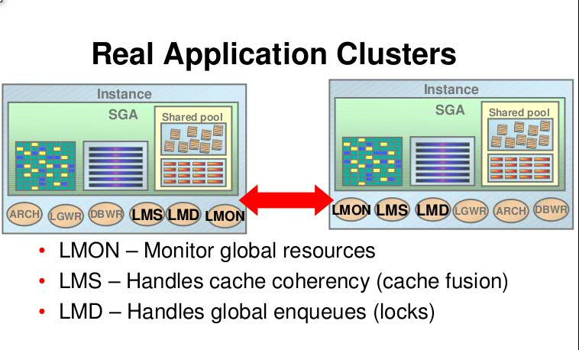

Slide 10
Background Processes
Each RAC instance has set of standard background processes e.g.
  PMON
  SMON
  LGWR
  DBWn
  ARCn
RAC instances use additional background processes to support GCS and GES including
  LMON
  LCK0
  LMDn
  LMSn
  DIAG

Slide 11
In Real Application Clusters, extra background processes are started. Some of the
important ones of these are shown on this slide:
•LMON is responsible for monitoring of all global resources, i.e. global cache
resources and global enqueue (lock) resources. Whenever a node is added or
removed from the cluster, the LMON process will distribute the global resources on
all nodes. In case of a loss of a node, this involves recovery of global resources
from the surviving nodes.
•The LMSn processes actually implement the Oracle cache fusion mechanism. This
makes sure only one node is modifying a block at any one time, it will send dirty
blocks between instances if multiple instances have block modifications to perform and it will construct and ship read-consistent blocks if one instance need to read a
block, that has been modified by another instance.
•The LMDn processes make the enqueues (e.g. row locks) – that in the non-RAC
case is handled internally on one instance – global, so that they can be seen by all
Instances.
Global Cache Service Processes (LMSn)
LMSn processes control the flow of messages to remote instances and manage global data block access.
LMSn processes also transmit block images between the buffer caches of different instances. This

Slide 12
processing is part of the Cache Fusion feature. n ranges from 0 to 9 depending on the amount of
messaging traffic.
•Global Enqueue Service Monitor (LMON)
Monitors global enqueues and resources across the cluster and performs global enqueue recovery
operations. Enqueues are shared memory structures that serialize row updates.
•Global Enqueue Service Daemon (LMD)
Manages global enqueue and global resource access. Within each instance, the LMD process manages
incoming remote resource requests.
•Lock Process (LCK)
Manages non-Cache Fusion resource requests such as library and row cache requests.
•Diagnosability Daemon (DIAG)
Captures diagnostic data about process failures within instances. The operation of this daemon is
automated and it updates an alert log file to record the activity that it performs.

Slide 13
Advantage of RAC
  Increasing availability
  Increasing scalability
  Improving maintainability
  RAC Increase Availability
Depends on definition of availability
  May achieve less unplanned downtime
  May have more time to respond to failures
Instance failover means any node can fail without total loss of service
Must have capacity in cluster to survive failover
  Additional Oracle and RAC licenses
  Load can be distributed over all running nodes
  RAC increase scalability
Scalability is the relationship between increments of resources and workloads
Can be any resource but with RAC normally refers to adding instances

Slide 14
Instances versus Databases
A RAC database includes
  one database
  More than one instances
  RAC is nothing but a multi instance database
A database is a set of files
  Located on shared storage
  Contains all persistent resources
An instance is a set of memory structures and background processes
  Contain all temporal resources
  Can be started and stopped independently

Slide 15
Instances versus Databases
Public
Network
Private Network
(Interconnect)
Instance 1
Instance 2
Instance 3
Instance 4
Node 1
Node 2
Node 3
Node 4
Storage Network
Database

Slide 16
What is RAC Database
Multiple instances running on separate servers (nodes)
Single database on shared storage accessible to all nodes
Instances exchange information over an interconnect network
Node 1
Node 2
Instance 1
Instance 2
Interconnect
Local
Disk
Shared
Storage
Local
Disk

Slide 17
Located on shared storage accessible by all instances
Includes
  Control Files
  Data Files
  Online Redo Logs
  Server Parameter File
May optionally include
  Archived Redo Logs
  Backups
  Flashback Logs (Oracle 10.1 and above)
  Change Tracking Writer files (Oracle 10.1 and above)

Slide 18
Contents similar to single instance database except
  One redo thread per instance
ALTER DATABASE ADD LOGFILE THREAD 2
GROUP 3 SIZE 51200K,
GROUP 4 SIZE 51200K;
ALTER DATABASE ENABLE PUBLIC THREAD 2;
If using Automatic Undo Management also require one UNDO tablespace per instance
CREATE UNDO TABLESPACE "UNDOTBS2" DATAFILE SIZE 25600K AUTOEXTEND ON MAXSIZE UNLIMITED EXTENT MANAGEMENT LOCAL;
Additional dynamic performance views (V$, GV$ )
created by $ORACLE_HOME/rdbms/admin/catclust.sql

Slide 19
Server Parameter File
Introduced in Oracle 9.0.1
Must reside on shared storage
Shared by all RAC instances
Binary (not text) files
Parameters can be changed using ALTER SYSTEM
Can be backed up using the Recovery Manager (RMAN)
Created using
CREATE SPFILE [ = ‘SPFILE_NAME’ ]
FROM PFILE [ = ‘PFILE_NAME’ ];
init.ora file on each node must contain SPFILE parameter
SPFILE = <pathname>

Slide 20
Parameters
RAC uses same parameters as single-instance
  Some must be different on each instance
  Some must be same on each instance
Can be global or local
[*.]<parameter_name> = <value>
[<sid>]<parameter_name> = <value>
Must be set using ALTER SYSTEM statement
ALTER SYSTEM SET parameter = value
[ SCOPE = MEMORY | SPFILE | BOTH ]
[ SID = <sid>]
ALTER SYSTEM SET parameter = value
[ SCOPE = MEMORY | SPFILE | BOTH ]
[ SID = <*>]

Slide 21
Parameters
Some parameters must be same on each instance including *:
  ACTIVE_INSTANCE_COUNT
  ARCHIVE_LAG_TARGET
  CLUSTER_DATABASE
  CONTROL_FILES
  DB_BLOCK_SIZE
  DB_DOMAIN
  DB_FILES
  DB_NAME
  DB_RECOVERY_FILE_DEST
  DB_RECOVERY_FILE_DEST_SIZE
  DB_UNIQUE_NAME
  UNDO_MANAGEMENT
Some parameters, if used, must be different on each instance including
  THREAD
  INSTANCE_NUMBER
  INSTANCE_NAME
  UNDO_TABLESPACE

Slide 22
Oracle Cluster Registry and Voting Disks
Oracle Clusterware includes two important components that manage configuration and node membership: Oracle Cluster Registry (OCR), which also includes the local component Oracle Local Registry (OLR), and voting disks.
OCR manages Oracle Clusterware and Oracle RAC database configuration information
OLR resides on every node in the cluster and manages Oracle Clusterware configuration information for each particular node
Voting disks manage information about node membership.
Oracle Cluster Registry (OCR)
  Configuration information for Oracle Clusterware / CRS
Introduced in Oracle 10.1
Similar to Windows Registry
Located on shared storage
For node-specific resources, each cluster node has a local
registry called an Oracle Local Registry (OLR).

Slide 23
Run the following command to list the backup files:
ocrconfig –showbackup
The default location for generating backups on Linux or UNIX systems is Grid_home/cdata/cluster_name
By default, OLR is located at Grid_home/cdata/host_name.olr on each node.
Manage OLR using the OCRCHECK, OCRDUMP, and OCRCONFIG utilities as root with the -local option.
You can check the status of OLR on the local node using the OCRCHECK utility, as follows:
# ocrcheck -local
Status of Oracle Cluster Registry is as follows :
Version : 3
Total space (kbytes) : 262132
Used space (kbytes) : 9200
Available space (kbytes) : 252932
ID : 604793089
Device/File Name : /private2/crs/cdata/localhost/dglnx6.olr
Device/File integrity check succeeded
Local OCR integrity check succeeded

Slide 24
Defines cluster resources including:
Databases
Instances
RDBMS
ASM
Services
Node Applications
VIP
ONS
GSD
Listener Process

Slide 25
Verify the integrity of OCR
# ocrcheck
The dd commands used to back up and recover voting disks in previous versions of Oracle Clusterware are not supported in Oracle Clusterware 11g release 2 (11.2). Restoring voting disks that were copied using dd or cp commands can prevent the Oracle Clusterware 11g release 2 (11.2) stack from coming up. Use the backup and restore procedures described in this chapter to ensure proper voting disk functionality.

Slide 26
What is a Voting Disk
Known as Quorum Disk / File in Oracle 9i
Located on shared storage accessible to all instances
Used to determine RAC instance membership
In the event of node failure voting disk is used to determine which instance takes control of cluster
  Avoids split brain
In Oracle 10.2 and above can be mirrored
  Odd number of copies (1, 3, 5 etc)
In Oracle Clusterware 12c, voting disk data is backed up
automatically in the OCR as part of any configuration
change.In RAC, CSSD processes (Cluster Services Synchronization Daemon) monitor the health of RAC nodes employing two distinct heart beats: Network heart beat and Disk heart beat. Healthy nodes will have continuous network and disk heartbeats exchanged between the nodes. Break in heart beat indicates a possible error scenario. There are few different scenarios possible with missing heart beats:
Network heart beat is successful, but disk heart beat is missed.
Disk heart beat is successful, but network heart beat is missed.
Both heart beats failed.

Slide 27
What is VIP
Node application introduced in Oracle 10.1
Allows Virtual IP address to be defined for each node
All applications connect using Virtual IP addresses
If node fails Virtual IP address is automatically relocated to another node
Only applies to newly connecting sessions. It enable a faster failover in the event of node failure

Slide 28
What is the Interconnect
Instances communicate with each other over the interconnect (network)
Information transferred between instances includes
  data blocks
  locks
Typically 1GB Ethernet
  UDP protocol
  Often teamed in pairs for redundancy
Oracle Interface Configuration Tool: oifcfg
The oifcfg command-line interface helps you to define and administer network interfaces.
The oifcfg is a command-line tool for both single-instance Oracle databases and Oracle RAC environments.
The oifcfg utility can direct components to use specific network interfaces.

Slide 29
Most cases: use UDP over 1 Gigabit Ethernet
For large databases - Infiniband/IP or 10 Gigabit Ethernet
Use OS Bonding/teaming to “virtualize” interconnect
Set UDP send/receive buffers high enough
Crossover cables are not supported
11GR2 Grid clusterware
29
Notes:
29

Slide 30
Why Use Shared Storage
Mandatory for
  Database files
  Control files
  Online redo logs
  Server Parameter file (if used)
Optional for
  Archived redo logs (recommended)
  Executables (Binaries)
    Password files
    Parameter files
    Network configuration files
  Administrative directories
    Alert Log
    Dump Files

Slide 31
What Shared Storage is Supported
Oracle supplied options
  Oracle Cluster File System (OCFS)
  Automatic Storage Management (ASM)
  Both require underlying SAN or NAS
Raw devices
Difficult to administer
Cannot be used with archived redo logs

Slide 32
Internal Structures and Services
Resource Affinity: Dynamically change in ownership of resources in a RAC system is called resource affinity
Cache Coherence: Maintaining consistency of the data across all the RAC instances is called CACHE COHERENCE
Global Resource Directory (GRD)
  Records current state and owner of each resource
  Contains convert and write queues
  Distributed across all instances in cluster
  Location of most current version of the block
  Role and mode of resource
  in a RAC every resource is identified by its role and mode.The role of resource could be whether local and Global and Mode of the resource could be wheather NULL,SHARE or EXCLUSIVE
Global Cache Services (GCS)
  It plays a vital role in cache fusion and keep trace of the role and mode of resource.
  Coordinates access to database blocks for instances
  Maintains GRD
Global Enqueue Services (GES)
  Controls access to other resources (locks) including
    library cache
    dictionary cache

Slide 33
Cache Fusion Architecture
RAC – important features
Movement of data or transfer of data across instances through private interconnect is called CACHE FUSION
• The cache becomes global
Global Cache Management is required
• Many locks become global
Global lock management is required
Full Cache Fusion
  Cache-to-cache data shipping through interconnect
  Shared cache eliminates
  slow I/O
Users
Cache Fusion
Shared Cache

Slide 34
Full Cache Fusion
Cache Fusion increases performance and scalability
  Data is shipped directly over high speed interconnect
  Minimize disk I/O
Node A
Node B
Data Transfer
Request
Database
buffers
Database
buffers
Database

Slide 35

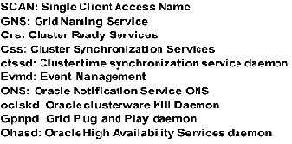
Grid CRS Start up sequence
DB Resource
SCAN Listener
Services
ONS
networkResource
SCAN VIPs
Node VIPs
ACFS Reg
GCS VIP
crsdRootAgent
crsdOraAgent
mdnsd
gipcd
ASM
gpnpd
evmd
crsd
ctssd
Diskmon
ACFS
oraRootAgent
oraAgent
cssdAgent
cssdMonitor
OHASD
35
Notes:
35

Slide 36
Clusterware verification
Clusterware processes
–
$ ps -ef|grep -v grep |grep d.bin
oracle 9824 1 0 Jul14 ? 00:00:00 /u01/app/grid11gR2/bin/oclskd.bin
root 22161 1 0 Jul13 ? 00:00:15 /u01/app/grid11gR2/bin/ohasd.bin reboot
oracle 24161 1 0 Jul13 ? 00:00:00 /u01/app/grid11gR2/bin/mdnsd.bin
oracle 24172 1 0 Jul13 ? 00:00:00 /u01/app/grid11gR2/bin/gipcd.bin
oracle 24183 1 0 Jul13 ? 00:00:03 /u01/app/grid11gR2/bin/gpnpd.bin
oracle 24257 1 0 Jul13 ? 00:01:26 /u01/app/grid11gR2/bin/ocssd.bin
root 24309 1 0 Jul13 ? 00:00:06 /u01/app/grid11gR2/bin/octssd.bin
root 24323 1 0 Jul13 ? 00:01:03 /u01/app/grid11gR2/bin/crsd.bin reboot
root 24346 1 0 Jul13 ? 00:00:00 /u01/app/grid11gR2/bin/oclskd.bin
oracle 24374 1 0 Jul13 ? 00:00:03 /u01/app/grid11gR2/bin/evmd.bin
36
Notes:
36

Slide 37
Clusterware verification
Clusterware checks
–
$ crsctl check crs
CRS-4638: Oracle High Availability Services is online
CRS-4537: Cluster Ready Services is online
CRS-4529: Cluster Synchronization Services is online
CRS-4533: Event Manager is online $ crsctl check has
CRS-4638: Oracle High Availability Services is online
$ crsctl query crs activeversion
Oracle Clusterware active version on the cluster is [11.2.0.2.0]
37

Slide 38
Clusterware verification
Clusterware processes
$ crsctl check cluster -all
**************************************************************
rat-rm2-ipfix006:
CRS-4537: Cluster Ready Services is online
CRS-4529: Cluster Synchronization Services is online
CRS-4533: Event Manager is online
**************************************************************
rat-rm2-ipfix007:
CRS-4537: Cluster Ready Services is online
CRS-4529: Cluster Synchronization Services is online
CRS-4533: Event Manager is online
**************************************************************
rat-rm2-ipfix008:
CRS-4537: Cluster Ready Services is online
CRS-4529: Cluster Synchronization Services is online
CRS-4533: Event Manager is online
**************************************************************
38

Slide 39
Clusterware verification
$ crsctl status resource -t
NAME TARGET STATE SERVER STATE_DETAILS
------------------------------------------------
ora.DATA.dg ⬅ ASM disk group (new resource)
ONLINE ONLINE rat-rm2-ipfix006
ONLINE ONLINE rat-rm2-ipfix007
ONLINE ONLINE rat-rm2-ipfix008
ora.LISTENER.lsnr
ONLINE ONLINE rat-rm2-ipfix006
ONLINE ONLINE rat-rm2-ipfix007
ONLINE ONLINE rat-rm2-ipfix008
ora.asm
ONLINE ONLINE rat-rm2-ipfix006 Started
ONLINE ONLINE rat-rm2-ipfix007 Started
ONLINE ONLINE rat-rm2-ipfix008 Started
ora.eons new resource
ONLINE ONLINE rat-rm2-ipfix006
ONLINE ONLINE rat-rm2-ipfix007
ONLINE ONLINE rat-rm2-ipfix008
ora.gsd
11GR2 Grid Clusterware
39

Slide 40
Load Balancing
LOAD BALANCING: The Oracle RAC system can distribute the load over running nodes this feature called as load balancing.
There are two methods of load balancing
1.Client load balancing
2.Server load balancing
Client Load Balancing distributes new connections among Oracle RAC nodes means it enables clients to randomize connection request among all the available listener. so that no one server is overloaded with connection requests and it is configured at net service name level by providing multiple descriptions in a description list or multiple addresses in an address list. For example, if connection fails over to another node in case of failure, the client load balancing ensures that the redirected connections are distributed among the other nodes in the RAC.
Configure Client-side connect-time load balancing by setting LOAD_BALANCE=ON in the corresponding client side TNS entry.
TESTRAC =
(DESCRIPTION =
(ADDRESS_LIST=
(LOAD_BALANCE = ON)
(ADDRESS = (PROTOCOL = TCP)(HOST = TESTRAC1-VIP)(PORT = 1521))
(ADDRESS = (PROTOCOL = TCP)(HOST = TESTRAC2-VIP)(PORT = 1521))
)
(CONNECT_DATA = (SERVICE_NAME = testdb.oracleracexpert.com))
)

Slide 41
Server -side load Balancing
Server-side connection balancing
Dependent on current workload on each node
PMON monitors workload and updates listeners
It does so using two important parameter local_listerner and remote_listener. The local listener should be set to node virtual ip address

Slide 42
Server Side Load Balancing
PMON process communicates with other listeners and distributes processing workload among Oracle RAC nodes. It divides the connection load evenly between all available listeners and distributes new user session connection requests to the least loaded listener(s) based on the total number of sessions which are already connected. Each listener communicates with the other listener(s) via each database instance’s PMON.PMON process registers database with database’s local listener
Cross-registers database with listeners on all other nodes in the cluster
PMON by default checks CPU every 3 seconds
PMON updates the listener with statistics.
By default, PMON updates TNSLSNR every 10 minutes.
Listener routes incoming connections to the least loaded instance.
Server Side Load Balancing
TNSNAMES entry
LISTENERS_RACDB =
(ADDRESS_LIST =
(ADDRESS = (PROTOCOL = TCP)(HOST = rac1-vip)(PORT = 1521))
(ADDRESS = (PROTOCOL = TCP)(HOST = rac2-vip)(PORT = 1521))
(ADDRESS = (PROTOCOL = TCP)(HOST = rac3-vip)(PORT = 1521))
42
Notes:
42

Slide 44
What is TAF
TAF is Transparent Application Failover .it is a client-side feature that allows for clients to reconnect to surviving nodes in the event of a failure of an instance.
Sessions connected to a failed instance will be terminated
  Uncommitted transactions will be rolled back
Sessions can be reconnected to another instance automatically if using TAF
  Can optionally re-execute in-progress SELECT statements
    Statement re-executed with same SCN
    Fetches resume at point of failure
  Session state is lost including
    Session parameters
    Package variables
    Class and ADT instantiations

Slide 45
What is TAF?
The failover is configured in tnsnames.ora file, the TAF settings are placed in CONNECT_DATA section of the tnsnames.ora using FAILOVER_MODES parameters.
TAF Configuration Option
----------------------------------------------------------
(FAILOVER_MODE=(TYPE=SELECT)(METHOD=BASIC))
TYPE Parameter=
a) session- set to failover the session,if user's connection is lost, a new session is automatically created for the user on the backup node using the service name specified in the tnsnames.ora
b) select – set to enable users with open cursors to continue fetching on them after failure.
c) None= this is default, no failover functionality is used.
Method Parameter:
BASIC: set to establish connection at failover time.this option requires almost no work on backup server until failover time.
BACKUP/PRECONNECT: set to pre-established connection .this means a separate database connectionto the secondary(backup instance) is maintained all the time while there is connection to the primary instance.Specify a different net service name for backup instance connections. A backup should be specified when using PRECONNECT to pre-establish connections.

Slide 46
A BASIC sample configuration would look like
TESTRAC =
(DESCRIPTION =
(LOAD_BALANCE = ON)
(FAILOVER = ON)
(ADDRESS = (PROTOCOL = TCP)(HOST = TESTRAC1-VIP)(PORT = 1521))
(ADDRESS = (PROTOCOL = TCP)(HOST = TESTRAC1-VIP)(PORT = 1521))
(CONNECT_DATA =
(SERVICE_NAME = testdb.oracleracexpert.com)
(FAILOVER_MODE = (TYPE = SELECT)(METHOD = BASIC)(RETRIES = 180)(DELAY = 5))
))
A Pre connect sample configuration would look like
TESTDB1 =
(DESCRIPTION =
(LOAD_BALANCE = ON)
(FAILOVER = ON)
(ADDRESS = (PROTOCOL = TCP)(HOST = TESTRAC1-VIP)(PORT = 1521))
(ADDRESS = (PROTOCOL = TCP)(HOST = TESTRAC2-VIP)(PORT = 1521))
(CONNECT_DATA =
(SERVICE_NAME = testdb.oracleracexpert.com)
(FAILOVER_MODE = (TYPE = SELECT)(METHOD = PRECONNECT)(BACKUP=TESTDB2))
))

Slide 47
Scan Configuration
SCAN is give single point of access for clients to cluster, No need to modify tns entry after adding or deleting node.
SCAN -Single Client Access Name
  Failover - Faster relocation of services
  Better Load balancing
MTU package size of Network Adapter (NIC)
Few important points about SCAN
1.It is a better practice to have three SCAN IP addresses and three scan listeners to
provide fault tolerance.
2.These three SCAN IP addresses can be alive in any node of the cluster. If you have
more than three nodes in a cluster, then nodes joining initially to the cluster will
have SCAN resources running.
3.SCAN is an abstraction layer. In a huge cluster, client connect string do not need to
specify all nodes in a cluster. Even if the topology of the cluster changes, still, there
is no reason to change connect string.
4.SCAN and VIP addresses must be in the same subnet. Multiple subnets can be
created using
listener_networks, but redirection is not contained within the same
subnet.
SCAN listeners, introduced in 11gR2. SCAN listeners also act as a load balancing mechanism to manage workload. SCAN listeners simply acts as a redirection mechanism redirecting incoming connections to a local VIP listener.1.Connection request is made by the application connecting to the SCAN IP address and Port.
2.SCAN listener receives the service name and redirects the connection to the VIP listener servicing that service_name. SCAN listener uses load balancing statistics to choose a node if the service is preferred in more than one instance.
3. VIP listener bequeath connection process and the connection continue to create a new DB connection.
Parameter setup
Two parameters are used to configure these listeners in the database. Parameter remote_listener is set to scan_ip:1521 and the local_listener is set to a connect string connecting to local VIP listener.
PMON process registers the services with the listeners using local_listener and remote_listener
.
Configuration of these two parameters is of paramount importance since PMON service registration is the key for consistent successful connections.
Figure : SCAN redirection
47
Notes:
47

Slide 48
Scan Configuration
When client program connects to RAC database through SCAN name, SCAN listener will accept t he request and redirect the connection to local listener. To identify connection issue, first try to connect to each local listener through node VIP, then try each SCAN listener through each SCAN VIP.
To test through node VIP:
sqlplus <username>/<password>@<nodename-vip.domain>:<local-listener-port>/<service-name>
SCAN listeners, introduced in 11gR2. SCAN listeners also act as a load balancing mechanism to manage workload. SCAN listeners simply acts as a redirection mechanism redirecting incoming connections to a local VIP listener.1.Connection request is made by the application connecting to the SCAN IP address and Port.
2.SCAN listener receives the service name and redirects the connection to the VIP listener servicing that service_name. SCAN listener uses load balancing statistics to choose a node if the service is preferred in more than one instance.
3. VIP listener bequeath connection process and the connection continue to create a new DB connection.
Parameter setup
Two parameters are used to configure these listeners in the database. Parameter remote_listener is set to scan_ip:1521 and the local_listener is set to a connect string connecting to local VIP listener.
PMON process registers the services with the listeners using local_listener and remote_listener
.
Configuration of these two parameters is of paramount importance since PMON service registration is the key for consistent successful connections.
48
Notes:
48

Slide 49
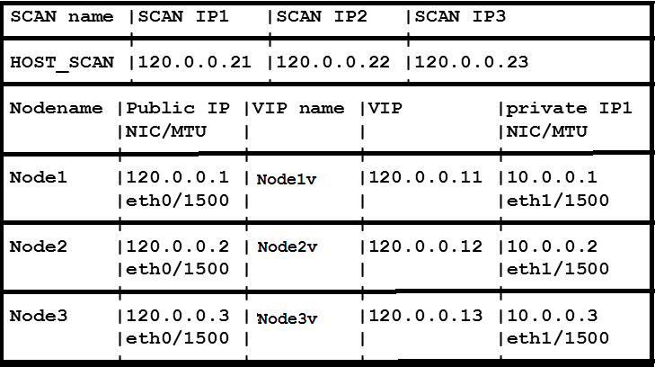
SCAN Configuration
11GR2 Grid clusterware
49
Notes:
49

Slide 50
SCAN VIP Troubleshooting
SCAN Configuration:
$GRID_HOME/bin/srvctl config scan
SCAN Listener Configuration:
$GRID_HOME/bin/srvctl config scan_listener
SCAN Listener Resource Status:
  $GRID_HOME/bin/crsctl stat res -w "TYPE = ora.scan_listener.type“
$GRID_HOME/Listener.ora
Local and remote listener parameters
50
Notes:
50

Slide 51
Scan Configuration
SCAN -Single Client Access Name
  Failover - Faster relocation of services
  Better Load balancing
MTU package size of Network Adapter (NIC)
SCAN listeners, introduced in 11gR2. SCAN listeners also act as a load balancing mechanism to manage workload. SCAN listeners simply acts as a redirection mechanism redirecting incoming connections to a local VIP listener.1.Connection request is made by the application connecting to the SCAN IP address and Port.
2.SCAN listener receives the service name and redirects the connection to the VIP listener servicing that service_name. SCAN listener uses load balancing statistics to choose a node if the service is preferred in more than one instance.
3. VIP listener bequeath connection process and the connection continue to create a new DB connection.
Parameter setup
Two parameters are used to configure these listeners in the database. Parameter remote_listener is set to scan_ip:1521 and the local_listener is set to a connect string connecting to local VIP listener.
PMON process registers the services with the listeners using local_listener and remote_listener
.
Configuration of these two parameters is of paramount importance since PMON service registration is the key for consistent successful connections.
Figure : SCAN redirection
51
Notes:
51

Slide 52
DBCA
Can be used to
  Create RAC database and instances
  Create ASM instance
  Manage ASM instance (10.2)
  Add RAC instances
  Create clone RAC database (10.2)
  Create, Manage and Drop Services
  Drop instances and database

Slide 53
What is SRVCTL
Utility used to manage cluster database
Configured in Oracle Cluster Registry (OCR)
Controls
  Database
  Instance
  ASM
  Listener
  Node Applications
  Services
Options include
  Start / Stop
  Enable / Disable
  Add / Delete
  Show current configuration
  Show current status

Slide 54
SRVCTL
Starting and Stopping a Database
srvctl start database -d RAC
srvctl stop database -d RAC
Starting and Stopping an Instance
srvctl start instance -d RAC -i RAC1
srvctl stop instance -d RAC -i RAC1
Starting and Stopping ASM on a specified node
srvctl start asm -n node1
srvctl stop asm -n node1

Slide 55
Some other Important Utilities
RAC utilities and diagnostics include
  OCRCONFIG
  OCRCHECK
  OCRDUMP
  CRSCTL
  CRS_STAT

Slide 56
BASIC RAC Commands
1) Check database instance on both node
ps -ef|grep pmon -to see database status
srvctl status database -d RONDB
2) check listener from both nodes
ps -ef|grep tns to see listerner status
3) check cluster status from grid owner user on node
crsctl check cluster -all
crsctl check crs --To check status of clusterware
crsctl status resource -t
crs_stat -t
4) Check whether sessions are balanced
select name,open_mode from v$database
select count(1),inst_id from gv$session group by inst_id
5) To know IP on server
ifconfig -a
6) to know RAC node
olsnodes -t -s
7) To check completed RAC database configuration
srvctl config database -d <database_name> -a
8) To know scan related details
srvctl config scan
lsnrctl status LISTENER_SCAN1
9) Clusterware log location
clusterware alert log (<GRID_HOME>/log/<hostname>/alert<hostname>.log)
crsd log (<GRID_HOME>/log/<hostname>/crsd/crsd.log)
cssd log ( $GI_HOME/log/nodename/cssd location)

Slide 57
Root Causes of Node Eviction
Network heartbeat lost
Voting disk problems
cssd is not healthy
Oprocd
Hang check timer
Important files to review are:
a) Each instance's alert log
b) Each instance's LMON trace file
c) awr reports from all nodes leading up to the eviction
d) Each node's syslog or messages file
e) iostat output before, after, and during evictions
f) vmstat output before, after, and during evictions
g) netstat output before, after, and during evictions
57
Notes:
57

Slide 58
Root Causes of Node Eviction
Appropriate ownership and permission of sub-directories and files in $GRID_HOME/log is critical for CRS components to come up properly
$GRID_ORACLE_HOME/log/<nodename>/alert<nodename>.log
$GRID_ORACLE_HOME/log/<nodename>/csdd/ocssd.log
$GRID_ORACLE_HOME/log/<nodename>/crsd/crsd.log
<grid-home>/log/<nodename>/ohasd/ohasd.log and ohasdOUT.log
58
Notes:
58

Slide 59
Root Causes of Node Eviction
Network heartbeat lost
Voting disk problems
cssd is not healthy
Oprocd
Hang check timer
Important files to review are:
a) Each instance's alert log
b) Each instance's LMON trace file
c) awr reports from all nodes leading up to the eviction
d) Each node's syslog or messages file
e) iostat output before, after, and during evictions
f) vmstat output before, after, and during evictions
g) netstat output before, after, and during evictions
59
Notes:
59

Slide 60
Root Causes of Node Eviction
Network heartbeat lost
Voting disk problems
cssd is not healthy
Oprocd
Hang check timer
Important files to review are:
a) Each instance's alert log
b) Each instance's LMON trace file
c) awr reports from all nodes leading up to the eviction
d) Each node's syslog or messages file
e) iostat output before, after, and during evictions
f) vmstat output before, after, and during evictions
g) netstat output before, after, and during evictions
60
Notes:
60

Slide 61
ASM OVERVIEW
ASM Overview
Disk and disk group
Initialization parameter file for ASM
Basic ASM Command
Notes:
Oracle Database 10g: Administration Workshop II 14-61
What Is Automatic Storage Management?
Automatic Storage Management (ASM) provides a vertical integration of the file system and the volume manager that is specifically built for the Oracle database files. ASM can provide management for single SMP machines, or across multiple nodes of a cluster for Oracle Real Application Clusters (RAC) support.
ASM distributes I/O load across all available resources to optimize performance while removing the need for manual I/O tuning. ASM helps DBAs to manage a dynamic database environment by allowing them to grow the database size without having to shutdown the database to adjust the storage allocation.
ASM can maintain redundant copies of data to provide fault tolerance, or it can be built on top of vendor supplied reliable storage mechanisms. Data management is done by selecting the desired reliability and performance characteristics for classes of data rather than with human interaction on a per file basis.
ASM capabilities save DBAs time by automating manual storage and thereby increasing their ability to manage larger databases and more of them with increased efficiency.

Slide 62
ASM OVERVIEW
ASM is a volume manager and a file system for Oracle Database files that supports single instance Oracle Database and Oracle RAC Database. Oracle ASM was introduce in oracle 10.1
Oracle ASM is Oracle’s recommended storage management solution that provides an alternative to conventional volume managers, file systems, and raw devices
Portable and high performance
  cluster file system
  Manages Oracle database files
  Data is spread across disks
  to balance load
  Integrated mirroring across
  disks
Application
Database
File
System
ASM
Volume
Manager
Operating System
Notes:
Oracle Database 10g: Administration Workshop II 14-62
What Is Automatic Storage Management?
Automatic Storage Management (ASM) provides a vertical integration of the file system and the volume manager that is specifically built for the Oracle database files. ASM can provide management for single SMP machines, or across multiple nodes of a cluster for Oracle Real Application Clusters (RAC) support.
ASM distributes I/O load across all available resources to optimize performance while removing the need for manual I/O tuning. ASM helps DBAs to manage a dynamic database environment by allowing them to grow the database size without having to shutdown the database to adjust the storage allocation.
ASM can maintain redundant copies of data to provide fault tolerance, or it can be built on top of vendor supplied reliable storage mechanisms. Data management is done by selecting the desired reliability and performance characteristics for classes of data rather than with human interaction on a per file basis.
ASM capabilities save DBAs time by automating manual storage and thereby increasing their ability to manage larger databases and more of them with increased efficiency.

Slide 63
ASM Overview
In order to use ASM in a RAC cluster, a separate ASM instance must be running on each node.it maintain metadata in the ASM disk group . The ASM instance must be started before other database instances .So database instance can access file located in ASM storage. The database instance communicates with the ASM instance to obtain information about file stored in ASM. ASM divides files into allocation units (AUs) and spreads the AUs for each file evenly across all the disk.. One unique advantage of ASM is that the mirroring is applied on a file basis, rather than on a volume basis.
ASM supports data files, log files, control files, archive logs, RMAN backup sets, and other Oracle database file types.
.
Disk Groups -Logical grouping of disks and determine file mirroring option
ASM Disks-LUNs presented to ASM
ASM Files -Files that are stored in ASM disk groups are called ASM files, this includes database files and ACFS-ADVM volume files
Notes:
Oracle Database 10g: Administration Workshop II 14-63
What Is Automatic Storage Management?
Automatic Storage Management (ASM) provides a vertical integration of the file system and the volume manager that is specifically built for the Oracle database files. ASM can provide management for single SMP machines, or across multiple nodes of a cluster for Oracle Real Application Clusters (RAC) support.
ASM distributes I/O load across all available resources to optimize performance while removing the need for manual I/O tuning. ASM helps DBAs to manage a dynamic database environment by allowing them to grow the database size without having to shutdown the database to adjust the storage allocation.
ASM can maintain redundant copies of data to provide fault tolerance, or it can be built on top of vendor supplied reliable storage mechanisms. Data management is done by selecting the desired reliability and performance characteristics for classes of data rather than with human interaction on a per file basis.
ASM capabilities save DBAs time by automating manual storage and thereby increasing their ability to manage larger databases and more of them with increased efficiency.

Slide 64
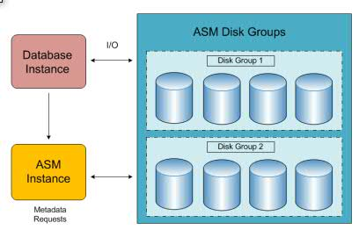
ASM is a cluster-aware logical volume manager that automates the layout of datafiles, control files and
redo log files by distributing them across all available disks assigned to an ASM disk group. When
creating a new tablespace or other database structure, such as a control file or redo log file, you can
specify a disk group as the storage area for the database structure instead of an operating system file. ASM
takes the ease of use of Oracle Managed Files (OMF) and combines it with mirroring and striping features
to provide a robust file system and logical volume manager that can even support multiple nodes in an
Oracle Real Application Cluster (RAC).
Automatic rebalancing is one of the key features of ASM. When an increase in disk space is needed,
additional disk devices can be dynamically added to a disk group, and ASM moves a proportional number
of extents from one or more existing disks to the new disks to maintain the overall I/O balance across all
disks. This happens in the background while the database objects contained in the disk files are still online
and available to users. To reduce the impact of the rebalancing operation on the I/O subsystem, the speed
at which the rebalance occurs can be changed or deferred using the initialization parameter
ASM_POWER_LIMIT.
ASM requires a special type of Oracle instance to provide the interface between a traditional Oracle
instance and the file system; the ASM software components are shipped with the Oracle Database or Grid
Infrastructure software and is a viable option for database storage.
Appendix - “Oracle 11g ASM on AIX with Oracle Real Applications Clusters (RAC)” will provide more
information about this chapter.

Slide 65
ASM Key Features and Benefits
The following are some key benefits of ASM:
ASM spreads I/O evenly across all available disk drives to prevent hot spots and maximize performance.
ASM eliminates the need for over provisioning and maximizes storage resource utilization facilitating database consolidation.
Inherent large file support.
Performs automatic online redistribution after the incremental addition or removal of storage capacity.
Maintains redundant copies of data to provide high availability, or leverages 3rd party RAID functionality.
For simplicity and easier migration to ASM, an Oracle database can contain ASM and non-ASM files. Any new files can be created as ASM files whilst existing files can also be migrated to ASM.
RMAN commands enable non-ASM managed files to be relocated to an ASM disk group.
Enterprise Manager Database Control or Grid Control can be used to manage ASM disk and file activities.
Notes:
ASM Key Features and Benefits
ASM divides files into extents, and spreads the extents for each file evenly across all of the disks. ASM uses an index technique to track the placement of each extent. When your storage capacity changes, ASM does not re-stripe all of the data, but moves an amount of data proportional to the amount of storage added or removed to evenly redistribute the files and maintain a balanced load across the disks. This is done while the database is active.
You can increase the speed of a rebalance operation, or lower it to reduce the impact on the I/O subsystem. ASM provides mirroring protection without the need to purchase a third-party Logical Volume Manager. One unique advantage of ASM is that the mirroring is applied on a file basis, rather than on a volume basis. Hence, the same disk group can contain a combination of files protected by mirroring, or not protected at all.
ASM supports data files, log files, control files, archive logs, RMAN backup sets, and other Oracle database file types. ASM supports Real Application Clusters and eliminate the need for a Cluster Logical Volume Manager or a Cluster File System.

Slide 66
ASM RAC Architecture
CLUSTERWARE
Clusterware
CLUSTERWARE
+ASM1
ASM
Instances
+ASM2
PROD1
TEST1
RDBMS Instances
PROD2
TEST2
PROD
TEST
Database Files

Slide 67
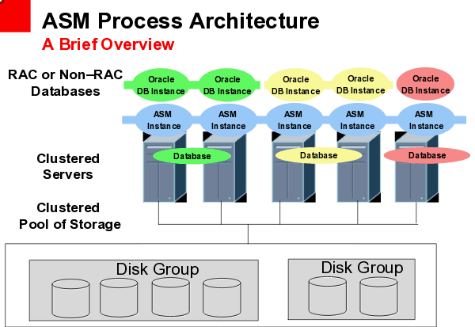
ASM Process Architecure
Notes:
67

Slide 68
There is one ASM instance per server. Even when there are several database instances on a single
server, each database shares a single ASM instance on that server.In a RAC configuration, each server in the cluster has an ASM instance.
Each of these instances communicates amongst themselves in the management and presentation of the file system.
•Each database instance coordinates file access through the ASM instance on the server for which it operates.
•Lastly, each ASM instance gathers performance related data from its associated database instance on its server.

Slide 69
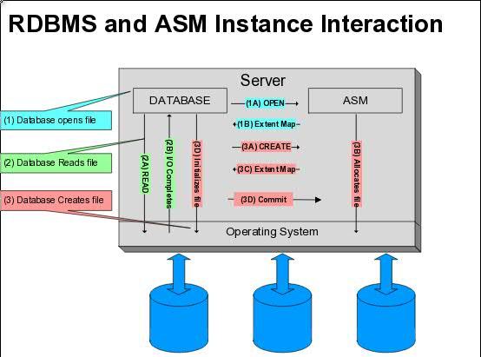

Slide 70
1A. Database issues open of a database file
1B. ASM sends the extent map for the file to database instance. Starting
with 11g, the RDBMS only receives first 60 extents
the remaining extents in the extent map are paged in on demand,
providing a faster open
2A/2B. Database now reads directly from disk
3A.RDBMS foreground initiates a create tablespace for example
3B. ASM does the allocation for its essentially reserving the allocation units for the file creation
3C. Once allocation phase is done, the extent map is sent to the RDBMS
3D. The RDBMS initialization phase kicks in. In this phase the initializes all
the reserved AUs
3E. If file creation is successful, then the RDBMS commits the file creation Going forward all I/Os are done by the RDBMS.

Slide 71
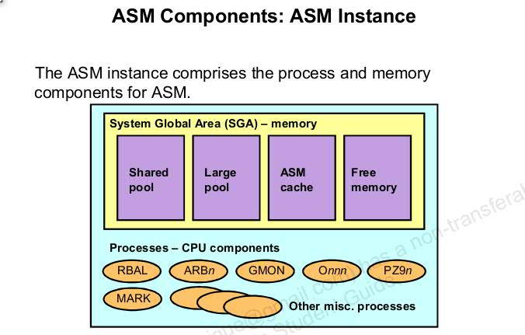
ASM Instance – it is instance that manages the metadata for disk group .The ASM instance, which is generally named +ASM, is started with the INSTANCE_TYPE=ASM init.ora parameter.Upon startup, an ASM instance will spawn all the basic background processes, plus some new ones that are specific to the operation of ASM.For RAC configurations, the ASM SID is +ASMx instance, where x represents the instance number
Notes:
71

Slide 72
Startup mode for ASM instance-The STARTUP clauses for ASM instances are similar to those for database instances
----------------------------------------
NOMOUNT- start up the ASM instance without mounting any disk
MOUNT – start up the ASM instance and mounts the disk group
OPEN – mount the disk groups and allows connection from database. This is default startup mount
RESTRICT prevents database instances from connecting to this ASM instance.
ASM Background Process
----------------------------------
RBAL: This background process coordinates disk re balancing activity. It also exist in RDBMS instances
ASMB: The background process is used for interaction between the CSS daemon,mainly during the initial connection to the ASM instance and a heartbeat mechanism with database instacne
DMON: The disk group monitor process manages disk group compatibility and monitors disk groups for offline disks in diskgroups
ARBn: The ASM rebalancing slave processes perform the actual rebalancing by moving data extents between disks. When completed ,The disk Expel slave process(Xnnn) will remove dropped disks from disk groups.

Slide 73
ASM Instance Initialization Parameters
INSTANCE_TYPE = ASM
DB_UNIQUE_NAME = +ASM
ASM_POWER_LIMIT = 1
ASM_DISKSTRING = '/dev/rdsk/*s2', '/dev/rdsk/c1*'
ASM_DISKGROUPS = dgroupA, dgroupB
LARGE_POOL_SIZE = 8MB
Notes:
Oracle Database 10g: Administration Workshop II 14-73
ASM Instance Initialization Parameters
INSTANCE_TYPE should be set to ASM for ASM instances.
DB_UNIQUE_NAME specifies the service provider name for which this ASM instance manages disk groups.The default value of +ASM should be valid for you. It needs to be modified only if you run multiple ASM instances on the same node.
ASM_POWER_LIMIT controls the speed for a rebalance operation. Values range from 1 to 11, with 11 being the fastest. If omitted, this value defaults to 1. The number of slaves is derived from the parallelization level specified in a manual rebalance command (POWER), or by the ASM_POWER_LIMIT parameter.
ASM_DISKSTRING is an operating system dependent value used by ASM to limit the set of disks considered for discovery.
ASM_DISK_GROUPS is the list of names of disk groups to be mounted by an ASM instance at startup, or when the ALTER DISKGROUP ALL MOUNT command is used.
The parameter INSTANCE_TYPE is the only parameter that you must define. All other ASM parameters have default values that are suitable for most environments.
Note: If the ASM environment has been created using the command line instead of EM, then the disk groups must be created before they can be mounted.

Slide 74
Starting Up an ASM Instance
$ sqlplus /nolog
SQL> CONNECT / AS sysdba
Connected to an idle instance.
SQL> STARTUP;
ASM instance started
Total System Global Area 147936196 bytes
Fixed Size 324548 bytes
Variable Size 96468992 bytes
Database Buffers 50331648 bytes
Redo Buffers 811008 bytes
ASM diskgroups mounted
Notes:
Oracle Database 10g: Administration Workshop II 14-74
Starting Up an ASM Instance
ASM instances are started similarly to database instances except that the initialization parameter file contains an entry like INSTANCE_TYPE=ASM. When this parameter is set to the value ASM, it informs the Oracle executable that an ASM instance is starting, not a database instance. Furthermore, for ASM instances, the mount option during startup tries to mount the disk groups specified by the ASM_DISKGROUPS initialization parameter. No database is mounted in this case.
Other STARTUP clauses have comparable interpretation for ASM instances as they do for database instances. For example, RESTRICT prevents database instances from connecting to this ASM instance. OPEN is invalid for an ASM instance. NOMOUNT startups ASM instance without mounting any disk group.

Slide 75


ASM Disk Groups
The ASM disk group is the fundamental object that ASM manages. It:
Consists of one or more ASM disks that provide space
ASM disks are the storage devices that are provisioned to ASM
Disk groups:
A pool of disks managed as
a logical unit
  Partitions total disk space into uniform sized units
  Spreads each file evenly across all disks
ASM
Instance
Disk Group
Notes:
Oracle Database 10g: Administration Workshop II 14-75
ASM Disk Groups
A disk group is a collection of disks managed as a logical unit. Storage is added and removed from disk groups in units of ASM disks. Every ASM disk has an ASM disk name which is a name common to all nodes in a cluster. The ASM disk name abstraction is required because different hosts can use different names to refer to the same disk.
ASM always evenly spreads files in 1MB allocation unit chunks across all of the disks in a disk group. This is called coarse striping. That way, ASM eliminates the need for manual disk tuning. However, disks in a disk group should have similar size and performance characteristics to obtain optimal I/O. For most installations there is only a small number of disk groups. For instance, one disk group for a work area, and one for a recovery area. For files, such as log files, that require low latency, ASM provides fine-grained (128K) striping. Fine striping stripes each allocation unit. Fine striping breaks up medium-sized I/O operations, into multiple smaller I/O operations that execute in parallel. While the number of files, and disks increase, you only have to manage a constant number of disk groups. From a database perspective, disk groups can be specified as the default location for files created in the database.
Note: Each disk group is self-describing, containing its own file directory, disk directory, and other directories.

Slide 76
How to Prepare Storage for ASM
ASM diskgroup will be created using one of the following storage resources:
1) Raw disk partition—A raw partition can be the entire disk drive or a section of a disk drive. However, the ASM disk cannot be in a partition that includes the partition table because the partition table can be overwritten.
2) Logical unit numbers (LUNs)—Using hardware RAID functionality to create LUNs is a recommended approach. Storage hardware RAID 0+1 or RAID5, and other RAID configurations, can be provided to ASM as ASM disks.
3) Raw logical volumes (LVM)—LVMs are supported in less complicated configurations where an LVM is mapped to a LUN, or an LVM uses disks or raw partitions. LVM configurations are not recommended by Oracle because they create a duplication of functionality. Oracle also does not recommended using LVMs for mirroring because ASM already provides mirroring.
4) NFS NAS files—If you have a certified NAS device, then you can create zero-padded files in an NFS mounted directory and use those files as disk devices in an Oracle Automatic Storage Management (Oracle ASM) diskgroup.

Slide 77
Redundancy
ASM Supports three levels of redundancy
External Redundancy
    Implemented externally using storage layer
    Most common configuration in production
  Normal Redundancy
    Two copies of each extent maintained in separate failure groups
    Used with extended clusters
    Used occasionally in production
    Increases CPU overhead on servers
  High Redundancy
    Three copies of each extent maintained in separate failure groups
    Very rare in production
    Failure Groups- it allows to take redundancy to disk to the next level,by creating a group containing disks from multiple controller.if controller fails and all of the disk associated with that controller are inaccessible, other disks within the disk group will still be accessible as long as connected to a different controller.,By creating a failure group withing the disk group, Oracle and ASM will mirror writes to disks and ensure that those writes are to disks within different failure groups so that loss of controller will not impact access to data

Slide 78
ASM Failure Groups - External Redundancy
Disk Group
Disk 1
Disk 2
Disk 3

Slide 79
ASM Failure Groups - Normal Redundancy
Disk Group
Failure Group 1
FailureGroup 2
Disk 1
Disk 2
Disk 3
Disk 4
Disk 5
Disk 6

Slide 80
ASM Failure Groups - High Redundancy
Disk Group
Failure Group 1
Failure Group 2
Failure Group 3
Disk 1
Disk 2
Disk 1
Disk 2
Disk 1
Disk 2

Slide 81
ASM Disk Groups and Disks
Disk Group 1
Disk Group 2
Disk Group 3
Disk 1
Disk 4
Disk 2
Disk 5
Disk 6
Disk 7
Disk 3

Slide 82
Creating and dropping disk group
Creating a disk group:
CREATE DISKGROUP diskgroup1
EXTERNAL REDUNDANCY
DISK '/dev/oracleasm/disks/VOL1';
Dropping a disk group:
DROP DISKGROUP diskgroup1
INCLUDING CONTENTS

Slide 83
Disk administration
Adding a disk
ALTER DISKGROUP diskgroup1
ADD DISK '/dev/oracleasm/disks/VOL2'
REBALANCE POWER 0;
Dropping a disk:
ALTER DISKGROUP diskgroup1
DROP DISK 'DISKGROUP1_0002'
REBALANCE POWER 0;
Rebalancing a disk group:
ALTER DISKGROUP diskgroup1
REBALANCE POWER 3;

Slide 84
Create or Delete Disk Groups
CREATE DISKGROUP dgroupA NORMAL REDUNDANCY
FAILGROUP controller1 DISK
'/devices/A1'
'/devices/A2',
FAILGROUP controller2 DISK
'/devices/B1',
'/devices/B2',
;
DROP DISKGROUP dgroupA INCLUDING CONTENTS;
Notes:
Oracle Database 10g: Administration Workshop II 14-84
Create or Delete Disk Groups
Assume that ASM disk discovery identified the following disks in the /devices directory : A1, A2, A3, B1, B2, and B3. Suppose that disks A1, A2, and A3 are on a separate SCSI controller from disks B1, B2, and B3. The first example illustrates how to configure a disk group called DGROUPA with two failure groups: CONTROLLER1 and CONTROLLER2.
The example also uses the default redundancy characteristic, NORMAL REDUNDANCY, for the disk group. You can optionally provide a disk name and size for the disk. If you do not supply this information, ASM creates a default name and attempts to determine the size of the disk. If the size cannot be determined, an error is returned. FORCE indicates that a specified disk should be added to the specified disk group even though the disk is already formatted as a member of an ASM disk group. Using the FORCE option for a disk that is not formatted as a member of an ASM disk group returns an error.
As shown by the second statement, you can delete a disk group along with all its files. To avoid accidental deletions, the INCLUDING CONTENTS option must be specified if the disk group still contains any files besides internal ASM metadata. The disk group must be mounted in order to drop it. After ensuring that none of the disk group files are open, the group and all its drives are removed from the disk group. Then the header of each disk is overwritten to eliminate the ASM formatting information.

Slide 85
ASMCMD Utility
Notes:
Oracle Database 10g: Administration Workshop II 14-85
Create or Delete Disk Groups
Assume that ASM disk discovery identified the following disks in the /devices directory : A1, A2, A3, B1, B2, and B3. Suppose that disks A1, A2, and A3 are on a separate SCSI controller from disks B1, B2, and B3. The first example illustrates how to configure a disk group called DGROUPA with two failure groups: CONTROLLER1 and CONTROLLER2.
The example also uses the default redundancy characteristic, NORMAL REDUNDANCY, for the disk group. You can optionally provide a disk name and size for the disk. If you do not supply this information, ASM creates a default name and attempts to determine the size of the disk. If the size cannot be determined, an error is returned. FORCE indicates that a specified disk should be added to the specified disk group even though the disk is already formatted as a member of an ASM disk group. Using the FORCE option for a disk that is not formatted as a member of an ASM disk group returns an error.
As shown by the second statement, you can delete a disk group along with all its files. To avoid accidental deletions, the INCLUDING CONTENTS option must be specified if the disk group still contains any files besides internal ASM metadata. The disk group must be mounted in order to drop it. After ensuring that none of the disk group files are open, the group and all its drives are removed from the disk group. Then the header of each disk is overwritten to eliminate the ASM formatting information.

Slide 86
Basic ASM Command
STARTUP/SHUTDOWN
ALTER DISKGROUP MOUNT/DISMOUNT
ALTER DISKGROUP ONLINE/OFFLINE DISK
The following commands are available to SYSOPER users:
ALTER DISKGROUP REBALANCE
ALTER DISKGROUP CHECK
SELECT all V$ASM_* views
All other commands, such as CREATE DISKGROUP, ADD/DROP/RESIZE DISK, and so on, require the SYSDBA privilege and are not allowed with the SYSOPER privilege.
To check space on ASM
column path FORMAT a40
select group_number,disk_number,path,mode_status,name from v$asm_disk order by group_number,disk_number,path;
select group_number,name,state,type,total_mb,free_mb,usable_file_mb from v$asm_diskgroup
select name, total_mb, free_mb, state from v$asm_diskgroup;
set lines 200 pages 200
SELECT g.group_number "Group"
, g.name "Group Name"
, g.state "State"
, g.type "Type"
, g.total_mb/1024 "Total GB"
, g.free_mb/1024 "Free GB"
, 100*(max((d.total_mb-d.free_mb)/d.total_mb)-min((d.total_mb-d.free_mb)/d.total_mb))/max((d.total_mb-d.free_mb)/d.total_mb) "Imbalance"
, 100*(max(d.total_mb)-min(d.total_mb))/max(d.total_mb) "Variance"
, 100*(min(d.free_mb/d.total_mb)) "MinFree"
, 100*(max(d.free_mb/d.total_mb)) "MaxFree"
, count(*) "DiskCnt"
FROM v$asm_disk d, v$asm_diskgroup g
WHERE d.group_number = g.group_number and
d.group_number <> 0 and
d.state = 'NORMAL' and
d.mount_status = 'CACHED'
GROUP BY g.group_number, g.name, g.state, g.type, g.total_mb, g.free_mb
ORDER BY 1;
86
Notes:
86

Slide 87
ASM Storage configuration
In 11gR2 ASM diskgroups are used
  Grid infrastructure - OCR, Voting disk and ASMspfile.
  Database - DATA and FRA.
OCR and voting disks for Grid clusterware
  OCR can now be stored in Automatic Storage Management (ASM).
  Add Second diskgroup for ocr using
    - ./ocrconfig -add +DATA02
Change the compatibility of the new diskgroup to 11.2 as follows:
ALTER DISKGROUP DATA02 SET ATTRIBUTE ‘COMPATIBILITY.ASM’=’11.2’;
ALTER DISKGROUP DATA02 SET ATTRIBUTE ‘COMPATIBILITY.RDBMS’=’11.2’;
11GR2 Grid clusterware
87
Notes:
87

Slide 88

Dynamic Performance View Additions
V$ASM_TEMPLATE
V$ASM_CLIENT
V$ASM_DISKGROUP
Disk group A
Disk group B
V$ASM_FILE
V$ASM_ALIAS
Storage system
V$ASM_DISK
V$ASM_OPERATION
Notes:
Oracle Database 10g: Administration Workshop II 14-88
Dynamic Performance View Additions

Slide 89
Monitoring Long-Running Operations Using V$ASM_OPERATION
Column | Description
GROUP_NUMBER | Disk group
OPERATION | Type of operation: REBAL
STATE | State of operation: QUEUED or RUNNING
POWER | Power requested for this operation
ACTUAL | Power allocated to this operation
SOFAR | Number of allocation units moved so far
EST_WORK | Estimated number of remaining allocation units
EST_RATE | Estimated number of allocation units moved per minute
EST_MINUTES | Estimated amount of time (in minutes) for operation termination
Notes:
Oracle Database 10g: Administration Workshop II 14-89
Monitoring Long-Running Operations Using V$ASM_OPERATION
The ALTER DISKGROUP DROP, RESIZE, and REBALANCE commands return before the operation is complete. To monitor progress of these long-running operations, you can query the V$ASM_OPERATION fixed view. This view is described in the table in this slide.

Slide 90
The procedures for preparing storage resources for ASM are:
1) Identify or create the storage devices for ASM by identifying all of the storage resource device names that you can use to create an ASM disk group. For example, on Linux systems, device names are typically presented from the /dev directory with the /dev/device_name_identifier name syntax or for AIX as below
cd /dev
ls -ltr /dev/rhdisk35
ls -ltr /dev/rhdisk36
2) Change the ownership and the permissions on storage device resources. For example, the following steps are required on Linux systems or AIX system:
2.1) Change the user and group ownership of devices to oracle:dba or grid:asmadmin
2.2) Change the device permissions to read/write
2.3) On older Linux versions, you must configure raw device binding
on AIX as below
chown -R grid:asmadmin /dev/rhdisk5
chown -R grid:asmadmin /dev/rhdisk6
chmod 660 /dev/rhdisk5
chmod 660 /dev/rhdisk6
After you have configured ASM, ensure that disk discovery has been configured correctly by setting the ASM_DISKSTRING initialization parameter.
Note: Setting the ownership to oracle:dba or grid:asmadmin is just one example that corresponds to the default settings. A non-default installation may require different settings. In general, the owner of the disk devices should be the same as the owner of the Oracle binary. The group ownership should be OSDBA of the ASM instance, which is defined at installation.

Slide 91
To check the current disk attach to relevant diskgroup
-----------------------------------------------------------
SELECT B.NAME, A.PATH, B.STATE, A.HEADER_STATUS, A.FREE_MB, A.TOTAL_MB
FROM V$ASM_DISK A, V$ASM_DISKGROUP B
where A.GROUP_NUMBER=B.GROUP_NUMBER
AND B.NAME like '%DISKGROUPNAME%'
order by path;
check for the candidate disk
---------------------------
SELECT HEADER_STATUS,TOTAL_MB,PATH FROM V$ASM_DISK;
set linesize 200
column path format a40
SQL> SELECT GROUP_NUMBER,DISK_NUMBER,REDUNDANCY,FAILGROUP ,HEADER_STATUS,state,TOTAL_MB,PATH FROM V$ASM_DISK;
GROUP_NUMBER DISK_NUMBER REDUNDA FAILGROUP HEADER_STATU STATE TOTAL_MB PATH
------------ ----------- ------- ------------------------------ ------------ -------- ---------- ----------------------------------------
0 4 UNKNOWN CANDIDATE NORMAL 0 /dev/rhdisk5
0 5 UNKNOWN CANDIDATE NORMAL 0 /dev/rhdisk6
1 0 UNKNOWN DATA1_0000 MEMBER NORMAL 512000 /dev/rhdisk1
2 0 UNKNOWN FRA1_0000 MEMBER NORMAL 102400 /dev/rhdisk2
3 0 UNKNOWN VOTING_0000 MEMBER NORMAL 500 /dev/rhdisk3
3 1 UNKNOWN VOTING_0001 MEMBER NORMAL 500 /dev/rhdisk4
SELECT HEADER_STATUS,OS_MB,TOTAL_MB,PATH FROM V$ASM_DISK WHERE HEADER_STATUS LIKE '%CANDIDA%' ORDER BY PATH;
HEADER_STATU TOTAL_MB PATH
------------ ---------- --------------------
CANDIDATE 0 /dev/rhdisk5
CANDIDATE 0 /dev/rhdisk6

Slide 92
Determine which diskgroup do you want to add
--------------------------------------------
select name, total_mb, free_mb, state from v$asm_diskgroup;
NAME TOTAL_MB FREE_MB STATE
------------------------------ ---------- ---------- -----------
DATA 3014656 418080 MOUNTED
FRA 1048576 998834 MOUNTED
OCRVOTE 12288 11356 MOUNTED
SSDDISK 524288 404805 MOUNTED
select dg.name dg_name, dg.state dg_state, dg.type, d.DISK_NUMBER dsk_no, d.MOUNT_STATUS, d.HEADER_STATUS, d.MODE_STATUS,
d.STATE, d. PATH, d.FAILGROUP FROM V$ASM_DISK d, v$asm_diskgroup dg
where dg.group_number(+)=d.group_number order by dg_name, dsk_no;
DG_NAME DG_STATE TYPE DSK_NO MOUNT_S HEADER_STATU MODE_ST STATE PATH FAILGROUP
--------------------- ------ ---------- ------- ------------ ------- -------- ------------------------------------
DATA1 MOUNTED EXTERN 0 CACHED MEMBER ONLINE NORMAL /dev/rhdisk1 DATA1_0000
FRA1 MOUNTED EXTERN 0 CACHED MEMBER ONLINE NORMAL /dev/rhdisk2 FRA1_0000
VOTING MOUNTED EXTERN 0 CACHED MEMBER ONLINE NORMAL /dev/rhdisk3 VOTING_0000
VOTING MOUNTED EXTERN 1 CACHED MEMBER ONLINE NORMAL /dev/rhdisk4 VOTING_0001
4 CLOSED CANDIDATE ONLINE NORMAL /dev/rhdisk5
5 CLOSED CANDIDATE ONLINE NORMAL /dev/rhdisk6
Alter or the candidate disk to the disk group
-----------------------------------------------
login as grid user and invoke sqlplus / as sysasm
then run command below
ALTER DISKGROUP FRA ADD DISK
'/dev/rhdisk5' NAME rhdisk5,
'/dev/rhdisk6' NAME rhdisk6;

Slide 93
How to Move a Datafile from Filesystem to ASM Using ASMCMD CP Command.
1) Make sure the datafile to be moved is OFFLINE
SQL> alter system switch logfile;
System altered.
SQL> select file_name, file_id from dba_data_files;
FILE_NAME FILE_ID
---------------------
/u01/oracle/oradata/test1.dbf 6
SQL> alter database datafile 6 offline;
Database altered.
SQL> select file_name, file_id, online_status from dba_data_files where file_id=6;
FILE_NAME FILE_ID ONLINE_STATUS
---------- -------
/u01/oracle/oradata/test1.dbf 6 RECOVER
2. Use ASMCMD to copy the file from filesystem to the diskgroup
ASMCMD> cp /u01/oracle/oradata/test1.dbf +DATA/LONDON/DATAFILE/test.dbf
copying /u01/oracle/oradata/test1.dbf -> +DATA/LONDON/DATAFILE/test.dbf
ASMCMD> ls -lt
Type Redund Striped Time Sys Name
N test.dbf => +DATA/ASM/DATAFILE/test.dbf.286.833718815
ASMCMD> pwd
+DATA/ASM/DATAFILE

Slide 94
3. Once the file is copied, rename the datafile
SQL> alter database rename file '/u01/oracle/oradata/test1.dbf' to '+DATA/LONDON/DATAFILE/test.dbf';
Database altered.
4. Recover the datafile and bring it ONLINE.
SQL> alter database recover datafile 6;
Database altered.
SQL> alter database datafile 6 online;
Database altered.
5. Confirm correct name and location:
SQL> select file_name, file_id, online_status from dba_data_files where file_id=6;
FILE_NAME FILE_ID ONLINE_STATUS
---------- -------
+DATA/london/datafile/test.dbf 6 ONLINE

Slide 95
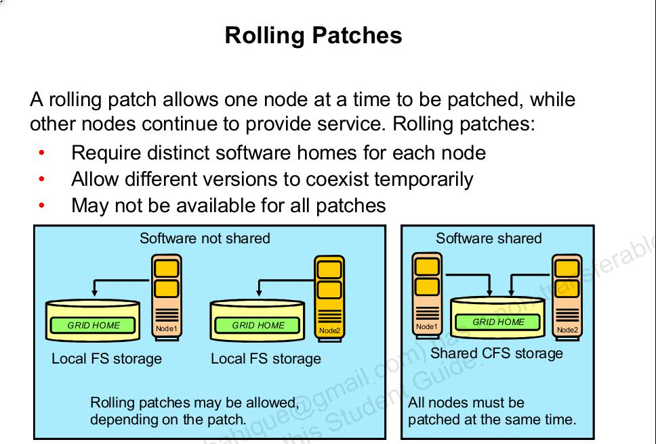

Slide 96
In rolling patching, one node will be shut down, the patch is applied to those nodes, and
nodes are brought back up. This is performed one by one, separately, until all the
nodes in the cluster are patched. This is the most efficient means of applying an interim patch
to an Oracle RAC or Oracle Grid Infrastructure . By patching one by one nodes, there is zero downtime for the cluster database because at least one
instance is available at all times on a different node.
Although most patches can be applied in a rolling fashion, some patches cannot be applied in
this fashion. The README file for the patch indicates whether or not you can apply the patch
by using the rolling patch method. If the patch cannot be applied using the rolling patch
method, then you must use either “Minimum Downtime Patching” or “All Node Patching” to
apply the patch
With rolling patches, the software version may be temporarily newer than the active version.
– To check the software version on a single node:
$ crsctl query crs softwareversion [hostname]
– To check the active version of the cluster:
$ crsctl query crs activeversion
Different versions should exist only while applyingo patch

Slide 97
OPatch Log and Trace Files
OPatch maintains logs for apply, rollback, and lsinventory operations.
OPatch Log files are located in
ORACLE_HOME/cfgtoollogs/opatch.
Each log file is tagged with the time stamp of the operation.
Each time you run OPatch, a new log file is created.
OPatch maintains an index of processed commands-and log files in the opatch_history.txt file

Slide 98
Oracle clusterware 11.2.0.4 PSU patching
Pre requisite
1-Stop oswatcher if running.
./stopOSWbb.sh (to stop OSWatcher)
2-Stop OEM agent (as oracle user) and check status of clusterware and Database
emctl stop agent (Stop the instance as an oracle user.)
crsctl stat res -t (Clusterware status)
ps -ef|grep pmon
ps -ef|grept tns
3-Validate the Grid inventory and hidden directory .patch_storage in Grid Home directory
[/u02/oracle/11.2.0.4/grid/Opatch] opatch lsinventory
if hidden folder is not create in Grid home.Please create it
cd $GI_HOME
ls -ltr
mkdir .patch_storage (as root)
later change permissions as software owner of Grid
eg:- chown <grid>:<oinstall> .patch_storage
4) To check whether PSU is rolling patch
$ORACLE_HOME/OPatch/opatch query -is_rolling_patch | grep rolling
5) Check opatch version if it is below as instructed in patch readme file,then download latest opatch utiltiy from Oracle support.
goxhill[/u02/oracle/11.2.0.4/grid/OPatch]$ ./opatch version
OPatch Version: 11.2.0.3.14
OPatch succeeded.

Slide 99
5) unzip the OPatch downloaded zip into ORACLE_HOME/OPatch directory after renaming already existing OPatch folder( as Grid user).
6) Check the opatch version .
Go to Grid home and check
[/u02/oracle/11.2.0.4/grid/OPatch]$ ./opatch version
7) run the precheck utility to see if any conflict patches are there or not
/staging/CH11353/22191577]$ /u02/oracle/11.2.0.4/grid/OPatch/opatch prereq CheckConflictAgainstOHWithDetail -ph ./
Oracle Interim Patch Installer version 11.2.0.3.14
Copyright (c) 2016, Oracle Corporation. All rights reserved.
PREREQ session
Oracle Home : /u02/oracle/11.2.0.4/grid
Central Inventory : /u02/oracle/oraInventory
from : /u02/oracle/11.2.0.4/grid/oraInst.loc
OPatch version : 11.2.0.3.14
OUI version : 11.2.0.4.0
Log file location : /u02/oracle/11.2.0.4/grid/cfgtoollogs/opatch/opatch2016-08-25_02-12-13AM_1.log
Invoking prereq "checkconflictagainstohwithdetail"
Prereq "checkConflictAgainstOHWithDetail" passed.
OPatch succeeded.

Slide 100
Implementation Plan
1) Stop database instance on master node using srvctl command.(As Grid user)
2) To take back up of Grid Home including the Oracle Inventory directory
eg
tar -cvf /backup/ch6339/oracle_inventory_pptdatabase.tar
server:/backup/ch6339 $echo $ORACLE_HOME
/oracle/product/databaseppt/11.2.0.1
server:databaseppt:/backup/ch6339 $
Go into the Oracle Home and execute below command
:databaseppt:/oracle/product/databaseppt/11.2.0.1 $ tar -cvf /backup/ch6339/oracle_home_crd44ppt.tar .
3) create ocm.rsp(oracle configuration manager) from Grid User and change the permission of the file to 775
[/home/oracrs]$ cd /u02/oracle/11.2.0.4/grid/OPatch/ocm/bin
[/u02/oracle/11.2.0.4/grid/OPatch/ocm/bin]$ ls -ltr
total 24
-rwxr-x--- 1 oracrs oinstall 9063 Nov 27 2009 emocmrsp[/u02/oracle/11.2.0.4/grid/OPatch/ocm/bin]$ ./emocmrsp
OCM Installation Response Generator 10.3.7.0.0 - Production
Copyright (c) 2005, 2012, Oracle and/or its affiliates. All rights reserved.
Provide your email address to be informed of security issues, install and
initiate Oracle Configuration Manager. Easier for you if you use your My
Oracle Support Email address/User Name.
Visit http://www.oracle.com/support/policies.html for details.
Email address/User Name:
You have not provided an email address for notification of security issues.
Do you wish to remain uninformed of security issues ([Y]es, [N]o) [N]: Y
The OCM configuration response file (ocm.rsp) was successfully created.

Slide 101
[/u02/oracle/11.2.0.4/grid/OPatch/ocm/bin]$ ls -ltr
total 32
-rwxr-x--- 1 oracrs oinstall 9063 Nov 27 2009 emocmrsp
-rw-r--r-- 1 oracrs oinstall 623 Aug 25 02:08 ocm.rsp
/u02/oracle/11.2.0.4/grid/OPatch/ocm/bin]$ chmod 775 ocm.rsp
[/u02/oracle/11.2.0.4/grid/OPatch/ocm/bin]$ ls -ltr
total 32
-rwxr-x--- 1 oracrs oinstall 9063 Nov 27 2009 emocmrsp
-rwxrwxr-x 1 oracrs oinstall 623 Aug 25 02:08 ocm.rsp
4- To patch only the GI home run the Opatch auto command mentioning Grid Home Path (from root user) on Node1
Note- there is not need to stop oracle instance and clusterware home opatch auto will stop and start automatically
Before executing OPatch, add the directory containing OPatch to the your path:
# export PATH=$PATH:<GI_HOME>/Opatch
[server:root:/u02/oracle/11.2.0.4/grid/bin:] id
uid=0(root) gid=0(system) groups=208(tivlogs)
[serverl:root:/u02/oracle/11.2.0.4/grid/bin:]
ls -ltr /staging/CH11353/22191577
ls -ltr /u02/oracle/11.2.0.4/grid/
ls -ltr /u02/oracle/11.2.0.4/grid/OPatch/ocm/bin/ocm.rsp
go to opatch directory

Slide 102
# opatchauto apply <UNZIPPED_PATCH_LOCATION> -oh
<Grid_home> -ocmrf <ocm_response_file>
cd /u02/oracle/11.2.0.4/grid/OPatch
[server:root:/u02/oracle/11.2.0.4/grid/Opatch:]
./opatch auto /staging/CH11353/22191577 -oh /u02/oracle/11.2.0.4/grid/ -ocmrf /u02/oracle/11.2.0.4/grid/Opatch/ocm/bin/ocm.rsp
or
/u02/oracle/11.2.0.4/OPatch/opatch auto /oswatcher/24436338 -oh $ORACLE_HOME -ocmrf $ORACLE_HOME/OPatch/ocm/bin/ocm.rsp
Repeat same steps on Node2
Post Implementation
1) Validate the Grid inventory by using lsinventory command
[/u02/oracle/11.2.0.4/grid/Opatch] opatch lsinventory
2) crs_stat -t
3) ./crsctl check crs
4) start database instance and oem if stop during activity
srvctl start instance -d <database_name> -i <instance_name>
5) check load balance of session
select count(1),inst_id,MACHINE from gv$session group by inst_id,MACHINE
select count(1),inst_id from gv$session group by inst_id

Slide 103
Thank you for listening

